Slide 1
Chapter 5 Image Restoration
(Overview)

Slide 2
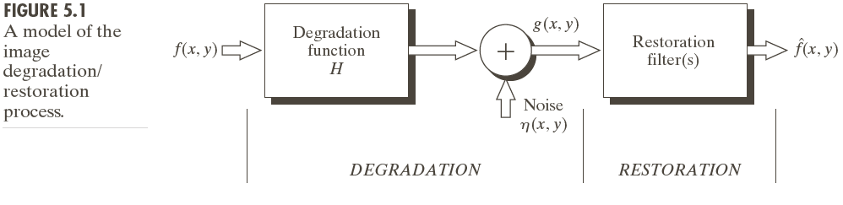
Degradation Model
g(x,y)=H[f(x,y)]+n(x,y)

Slide 3
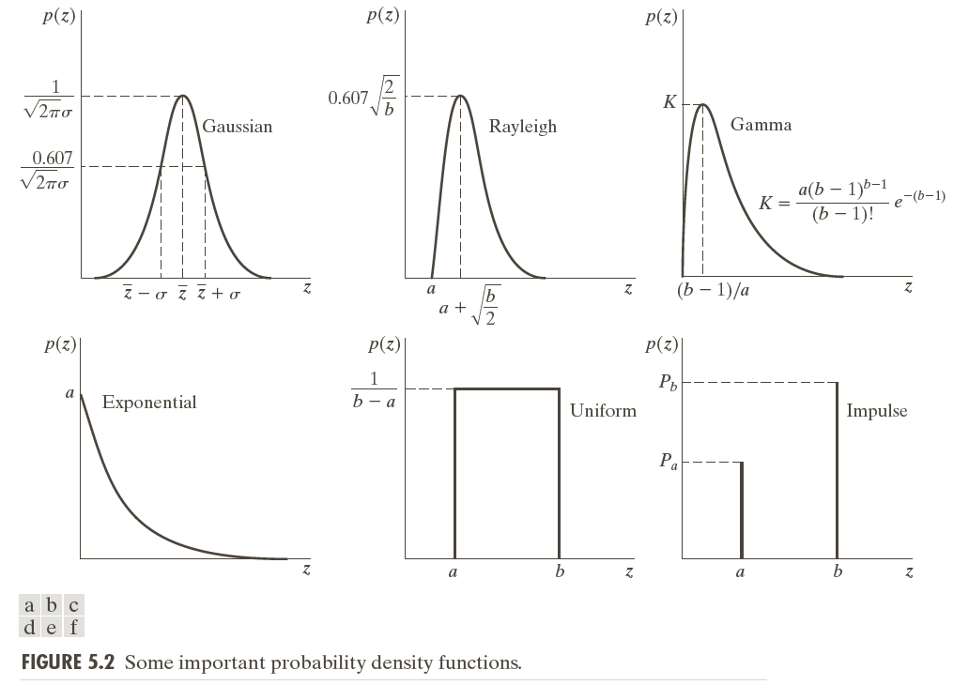

Slide 4

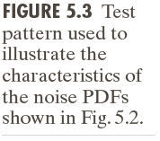

Slide 5
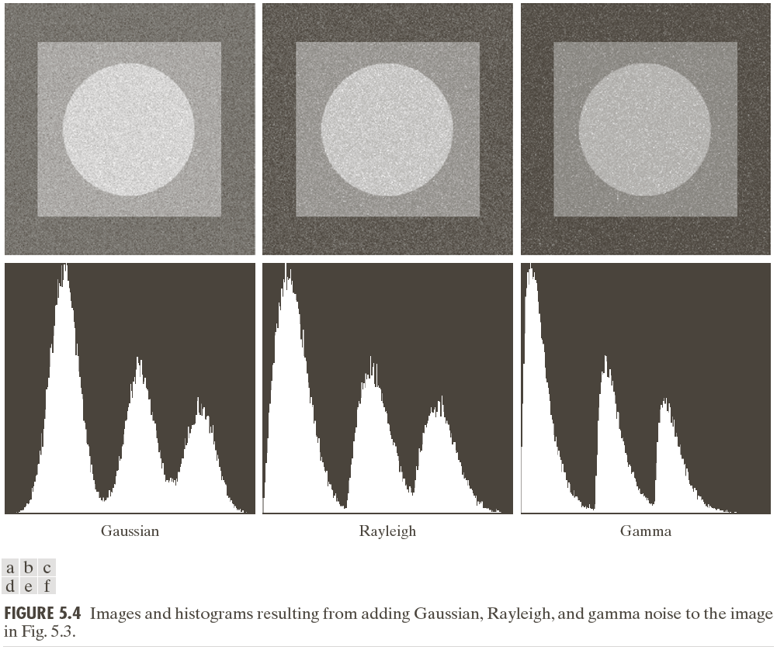

Slide 7
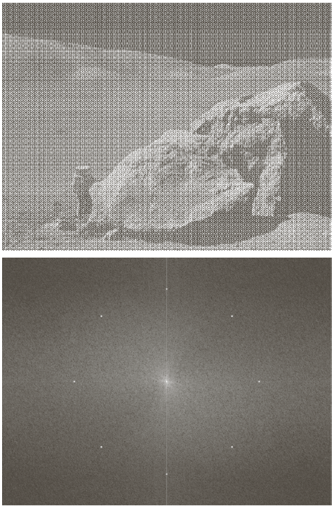
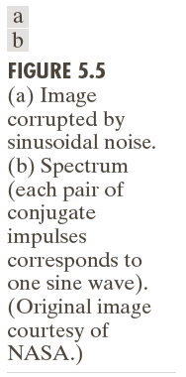

Slide 8
Spatial Filter
Averaging Smooth (Blur)
Gaussian Smooth (Blur)
Media Filter

Slide 9
Filtering In Frequency Domain
Band Reject Filter
Notch Reject Filter

Slide 10
Filtering In Frequency Domain
Notch Reject Filter

Slide 11
[Programming]
Generate a Gaussian Band Pass Filter
Parameters: r, σ
Generate a Gaussian Notch Pass Filter
Parameters: (u0,v0), σ

Slide 12
Inverse Filtering
Linear Degradation: G(u,v) = F(u,v) H(u,v)
H(u,v)
f(u,v)
g(x,y)

Slide 13
Inverse Filtering
?

